Slide 1


Users Get Routed: Traffic Correlation on Tor by Realistic Adversaries
Aaron Johnson¹ Chris Wacek² Rob Jansen¹
Micah Sherr² Paul Syverson¹
¹ U.S. Naval Research Laboratory, Washington, DC
² Georgetown University, Washington, DC
MPI-SWS
July 29, 2013

Slide 2

Summary: What is Tor?

Slide 3


Summary: What is Tor?
Tor is a system for anonymous communication.

Slide 4
Summary: What is Tor?
Tor is a system for anonymous communication.
^
popular
Over 500000 daily users and 2.4GiB/s aggregate

Slide 5
Summary: Who uses Tor?

Slide 6
Summary: Who uses Tor?
Individuals avoiding censorship
Individuals avoiding surveillance
Journalists protecting themselves or sources
Law enforcement during investigations
Intelligence analysts for gathering data

Slide 7
Summary: Tor’s Big Problem

Slide 8

Summary: Tor’s Big Problem

Slide 9
Summary: Tor’s Big Problem

Slide 10
Summary: Tor’s Big Problem

Slide 11
Summary: Tor’s Big Problem
Traffic Correlation Attack

Slide 12
Summary: Tor’s Big Problem
Traffic Correlation Attack
Congestion attacks
Throughput attacks
Latency leaks
Website fingerprinting
Application-layer leaks
Denial-of-Service attacks

Slide 13
Summary: Our Contributions

Slide 14
Summary: Our Contributions
Empirical analysis of traffic correlation threat
Develop adversary framework and security metrics
Develop analysis methodology and tools

Slide 15
Overview
Summary
Tor Background
Tor Security Analysis
  Adversary Framework
  Security Metrics
  Evaluation Methodology
  Node Adversary Analysis
  Link Adversary Analysis
Future Work

Slide 16
Overview
Summary
Tor Background
Tor Security Analysis
  Adversary Framework
  Security Metrics
  Evaluation Methodology
  Node Adversary Analysis
  Link Adversary Analysis
Future Work

Slide 17

Background: Onion Routing
Users
Onion Routers
Destinations

Slide 18

Background: Onion Routing
Users
Onion Routers
Destinations

Slide 19
Background: Onion Routing
Users
Onion Routers
Destinations

Slide 20
Background: Onion Routing
Users
Onion Routers
Destinations

Slide 21
Background: Onion Routing
Users
Onion Routers
Destinations

Slide 22
Background: Using Circuits

Slide 23

Background: Using Circuits
Clients begin all circuits with a selected guard.

Slide 24

Background: Using Circuits
Clients begin all circuits with a selected guard.
Relays define individual exit policies.

Slide 25
Background: Using Circuits
Clients begin all circuits with a selected guard.
Relays define individual exit policies.
Clients multiplex streams over a circuit.

Slide 26
Background: Using Circuits
Clients begin all circuits with a selected guard.
Relays define individual exit policies.
Clients multiplex streams over a circuit.
New circuits replace existing ones periodically.

Slide 27
Overview
Summary
Tor Background
Tor Security Analysis
  Adversary Framework
  Security Metrics
  Evaluation Methodology
  Node Adversary Analysis
  Link Adversary Analysis
Future Work

Slide 28
Adversary Framework

Slide 29
Adversary Framework

Slide 30
Adversary Framework

Slide 31
Adversary Framework

Slide 32
Adversary Framework
Resource Types
Relays
Bandwidth
Autonomous Systems (ASes)
Internet Exchange Points (IXPs)
Money

Slide 33
Adversary Framework
Resource Types
Relays
Bandwidth
Autonomous Systems (ASes)
Internet Exchange Points (IXPs)
Money
Resource Endowment
Destination host
5% Tor bandwidth
Source AS
Equinix IXPs

Slide 34
Adversary Framework
Resource Types
Relays
Bandwidth
Autonomous Systems (ASes)
Internet Exchange Points (IXPs)
Money
Resource Endowment
Destination host
5% Tor bandwidth
Source AS
Equinix IXPs
Goal
Target a given user’s communication
Compromise as much traffic as possible
Learn who uses Tor
Learn what Tor is used for

Slide 35
Overview
Summary
Tor Background
Tor Security Analysis
  Adversary Framework
  Security Metrics
  Evaluation Methodology
  Node Adversary Analysis
  Link Adversary Analysis
Future Work

Slide 36
Security Metrics
Prior metrics

Slide 37
Security Metrics
Prior metrics
Probability of choosing bad guard and exit
  c² / n² : Adversary controls c of n relays
  ge : g guard and e exit BW fractions are bad

Slide 38
Security Metrics
Prior metrics
Probability of choosing bad guard and exit
  c² / n² : Adversary controls c of n relays
  ge : g guard and e exit BW fractions are bad
Probability some AS/IXP exists on both entry and exit paths (i.e. path independence)

Slide 39
Security Metrics
Prior metrics
Probability of choosing bad guard and exit
  c² / n² : Adversary controls c of n relays
  ge : g guard and e exit BW fractions are bad
Probability some AS/IXP exists on both entry and exit paths (i.e. path independence)
g_{t} : Probability of choosing malicious guard within time t

Slide 40
Security Metrics
Principles
Probability distribution
Measure on human timescales
Based on adversaries

Slide 41
Security Metrics
Principles
Probability distribution
Measure on human timescales
Based on adversaries
Metrics
Probability distribution of time until first path compromise
Probability distribution of number of path compromises for a given user over given time period

Slide 42
Overview
Background
Onion Routing Security Analysis
  Problem: Traffic correlation
  Adversary Model
  Security Metrics
  Evaluation Methodology
  Node Adversary Analysis
  Link Adversary Analysis
Future Work

Slide 43
TorPS: The Tor Path Simulator
Network Model
Relay statuses
Streams
Stream➔Circuit mappings
User Model
Client Software Model

Slide 44
TorPS: The Tor Path Simulator
Network Model
Relay statuses
Streams
Stream➔Circuit mappings
User Model
Client Software Model

Slide 45






TorPS: User Model
Gmail/GChat
Gcal/GDocs
Facebook
Web search
IRC
BitTorrent
20-minute traces

Slide 46
TorPS: User Model
Gmail/GChat
Gcal/GDocs
Typical
Facebook
Web search
IRC
BitTorrent
20-minute traces

Slide 47
TorPS: User Model
Session schedule
One session at 9:00, 12:00, 15:00, and 18:00 Su-Sa
Repeated sessions 8:00-17:00, M-F
Repeated sessions 0:00-6:00, Sa-Su
Gmail/GChat
Gcal/GDocs
Typical
Facebook
Web search
IRC
BitTorrent
20-minute traces

Slide 48
TorPS: User Model
Session schedule
One session at 9:00, 12:00, 15:00, and 18:00 Su-Sa
Repeated sessions 8:00-17:00, M-F
Repeated sessions 0:00-6:00, Sa-Su
Gmail/GChat
Gcal/GDocs
Typical
Facebook
Worst Port
(6523)
Web search
Best Port
(443)
IRC
BitTorrent
20-minute traces

Slide 49
TorPS: User Model
Rank | Port # | Exit BW % | Long-Lived | Application
1 | 8300 | 19.8 | Yes | iTunes?
2 | 6523 | 20.1 | Yes | Gobby
3 | 26 | 25.3 | No | (SMTP+1)
65312 | 993 | 89.8 | No | IMAP SSL
65313 | 80 | 90.1 | No | HTTP
65314 | 443 | 93.0 | No | HTTPS
Default-accept ports by exit capacity.

Slide 50
TorPS: User Model
Model | Streams/week | IPs | Ports (#s)
Typical | 2632 | 205 | 2 (80, 443)
IRC | 135 | 1 | 1 (6697)
BitTorrent | 6768 | 171 | 118
WorstPort | 2632 | 205 | 1 (6523)
BestPorst | 2632 | 205 | 1 (443)
User model stream activity

Slide 51
TorPS: The Tor Path Simulator
Network Model
Relay statuses
Streams
Stream➔Circuit mappings
User Model
Client Software Model

Slide 52

TorPS: The Tor Path Simulator
Network Model
metrics.torproject.org
Monthly server descriptors archive
Hourly consensuses

Slide 53
TorPS: The Tor Path Simulator
Network Model
Relay statuses
Streams
Stream➔Circuit mappings
User Model
Client Software Model

Slide 54
TorPS: The Tor Path Simulator
Client Software Model
Reimplemented path selection in Python
Based on current Tor stable version (0.2.3.25)
Major path selection features include
  Bandwidth weighting
  Exit policies
  Guards and guard rotation
  Hibernation
  /16 and family conflicts
Omits effects of network performance

Slide 55
Overview
Background
Onion Routing Security Analysis
  Problem: Traffic correlation
  Adversary Model
  Security Metrics
  Evaluation Methodology
  Node Adversary Analysis
  Link Adversary Analysis
Future Work

Slide 56
Node Adversary
100 MiB/s total bandwidth
Rank | Bandwidth (MiB/s) | Family
1 | 260.5 | torservers.net
2 | 115.7 | Chaos Computer Club
3 | 107.8 | DFRI
4 | 95.3 | Team Cymru
5 | 80.5 | Paint
Relay Type | Number | Bandwidth (GiB/s)
Any | 2646 | 3.10
Guard only | 670 | 1.25
Exit only | 403 | 0.30
Guard & Exit | 272 | 0.98
Tor relay capacity, 3/31/13
Top Tor families, 3/31/13

Slide 57
Node Adversary
100 MiB/s total bandwidth
Probability to compromise at least one stream and rate of compromise, 10/12 – 3/13.

Slide 58
Node Adversary
100 MiB/s total bandwidth
83.3 MiB/s guard,16.7 MiB/s exit

Slide 59
Node Adversary Results
Time to first compromised stream, 10/12 – 3/13
Fraction compromised streams, 10/12 – 3/13

Slide 60
Node Adversary Results
Time to first compromised guard, 10/12 – 3/13
Fraction streams with compromised guard, 10/12 – 3/13

Slide 61
Node Adversary Results
Time to first compromised exit, 10/12 – 3/13
Fraction compromised exits, 10/12 – 3/13

Slide 62
Node Adversary Results
Time to first compromised circuit, 10/12-3/13

Slide 63
Overview
Background
Onion Routing Security Analysis
  Problem: Traffic correlation
  Adversary Model
  Security Metrics
  Evaluation Methodology
  Node Adversary Analysis
  Link Adversary Analysis
Future Work

Slide 64
Link Adversary

Slide 65
Link Adversary
AS8
AS6
AS6
AS7
AS1
AS2
AS3
AS4
AS5
Autonomous Systems (ASes)

Slide 66

Link Adversary
AS8
AS6
AS6
AS7
AS1
AS2
AS3
AS4
AS5
Autonomous Systems (ASes)
Internet Exchange Points (IXPs)

Slide 67
Link Adversary
AS8
AS6
AS6
AS7
AS1
AS2
AS3
AS4
AS5
Autonomous Systems (ASes)
Internet Exchange Points (IXPs)
Adversary has fixed location

Slide 68
Link Adversary
AS8
AS6
AS6
AS7
AS1
AS2
AS3
AS4
AS5
Autonomous Systems (ASes)
Internet Exchange Points (IXPs)
Adversary has fixed location

Slide 69
Link Adversary
AS8
AS6
AS6
AS7
AS1
AS2
AS3
AS4
AS5
Autonomous Systems (ASes)
Internet Exchange Points (IXPs)
Adversary has fixed location
Adversary may control multiple entities
  “Top” ASes
  IXP organizations

Slide 70
Link Adversary
Client locations
Top 5 non-Chinese source ASes in Tor (Edman&Syverson 09)
AS# | Description | Country
3320 | Deutsche Telekom AG | Germany
3209 | Arcor | Germany
3269 | Telecom Italia | Italy
13184 | HanseNet Telekommunikation | Germany
6805 | Telefonica Deutschland | Germany
AS/IXP Locations
Ranked for client location by frequency on entry or exit paths
Exclude src/dst ASes
Top k ASes /top IXP organization
Type | ID | Description
AS | 3356 | Level 3 Communications
AS | 1299 | TeliaNet Global
AS | 6939 | Hurricane Electric
IXP | 286 | DE-CIX Frankfurt
IXP Org. | DE-CIX | DE-CIX
Example: Adversary locations for BitTorrent client in AS 3320

Slide 71
Link Adversary
# | IXP Organization | Size | Country
1 | Equinix | 26 | global
2 | PTTMetro | 8 | Brazil
3 | PIPE | 6 | Australia
4 | NIXI | 6 | India
5 | XChangePoint | 5 | global
6 | MAE/VERIZON | 5 | global
7 | Netnod | 5 | Sweden
8 | Any2 | 4 | US
9 | PIX | 4 | Canada
10 | JPNAP | 3 | Japan
11 | DE-CIX | 2 | Germany
12 | AEPROVI | 2 | Equador
13 | Vietnam | 2 | Vietnam
14 | NorthWestIX | 2 | Montana, US
15 | Terremark | 2 | global
16 | Telx | 2 | US
17 | NorrNod | 2 | Sweden
18 | ECIX | 2 | Germany
19 | JPIX | 2 | Japan
IXP organizations obtained by manual clustering based on PeerDB and PCH.
IXP organizations ranked by size

Slide 72
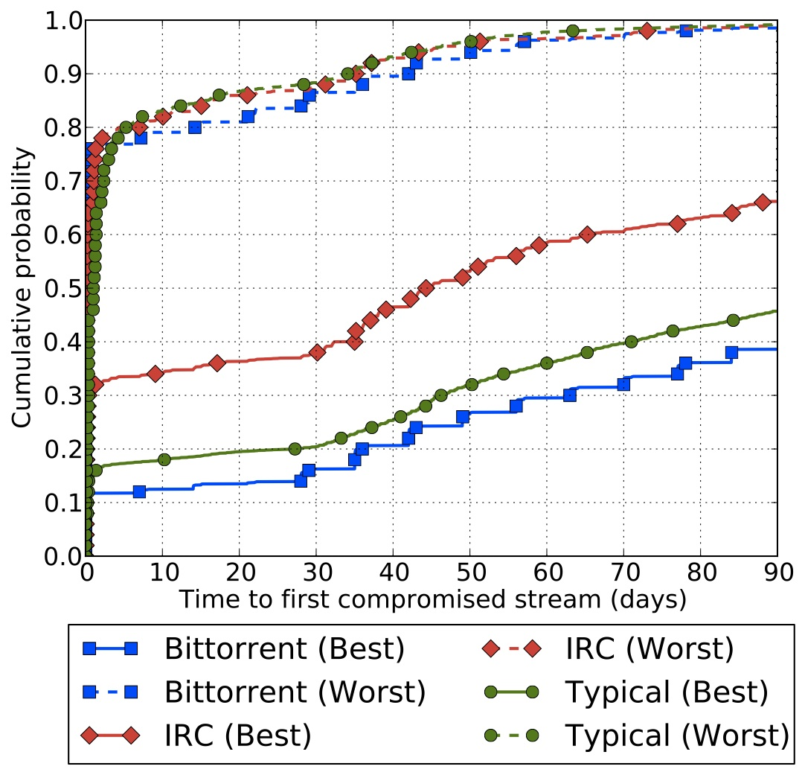
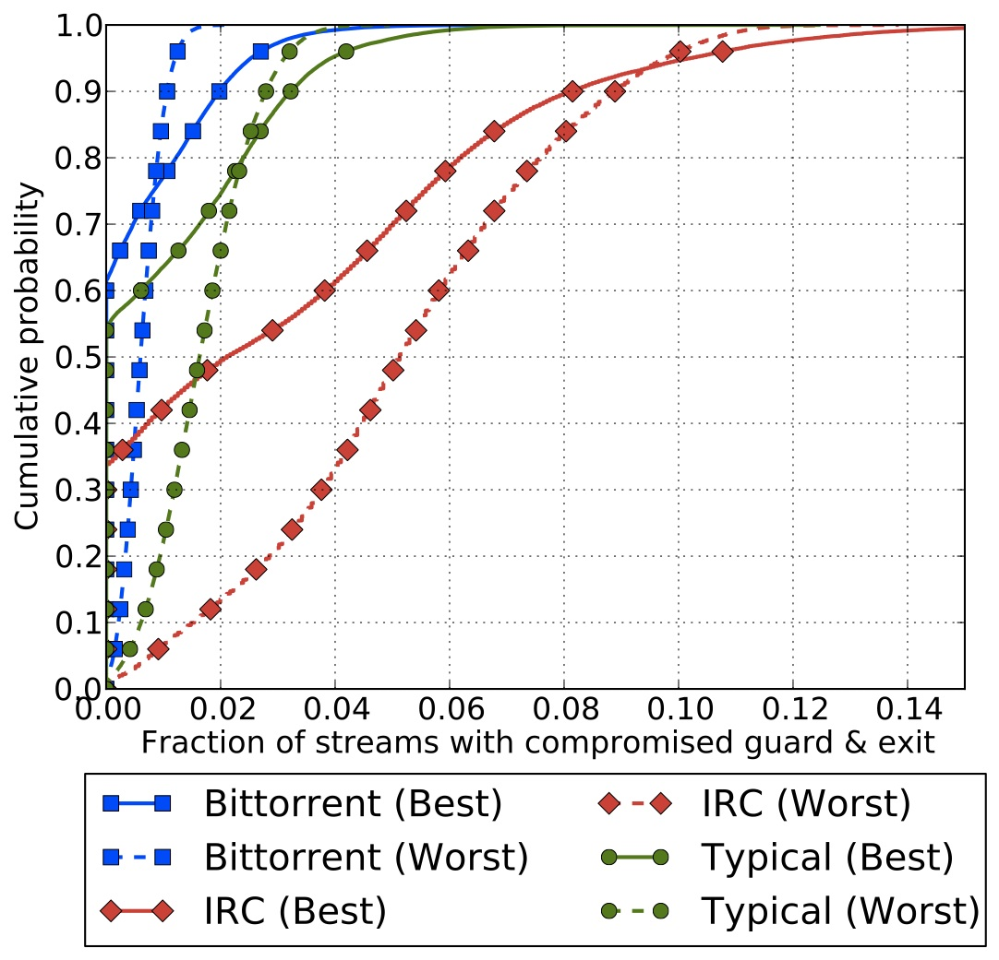
Link Adversary
Adversary controls one AS,
Time to first compromised stream, 1/13 – 3/13
“Best”: most secure client AS
“Worst”: least secure client AS
Adversary controls one AS,
Fraction compromised streams, 1/13 – 3/13
“Best”: most secure client AS
“Worst”: least secure client AS

Slide 73
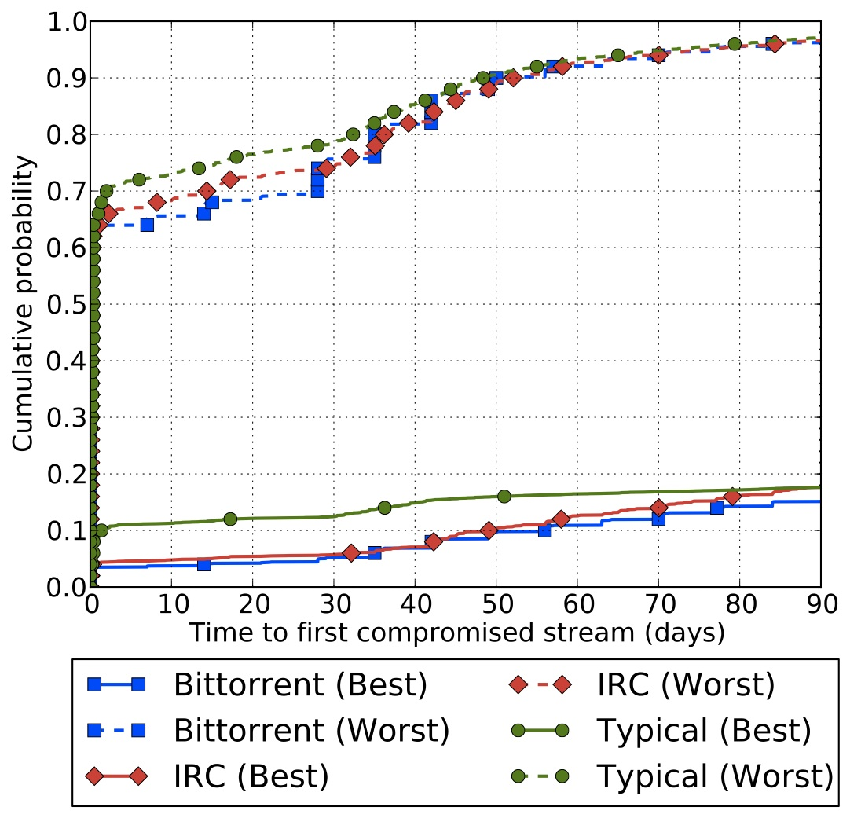
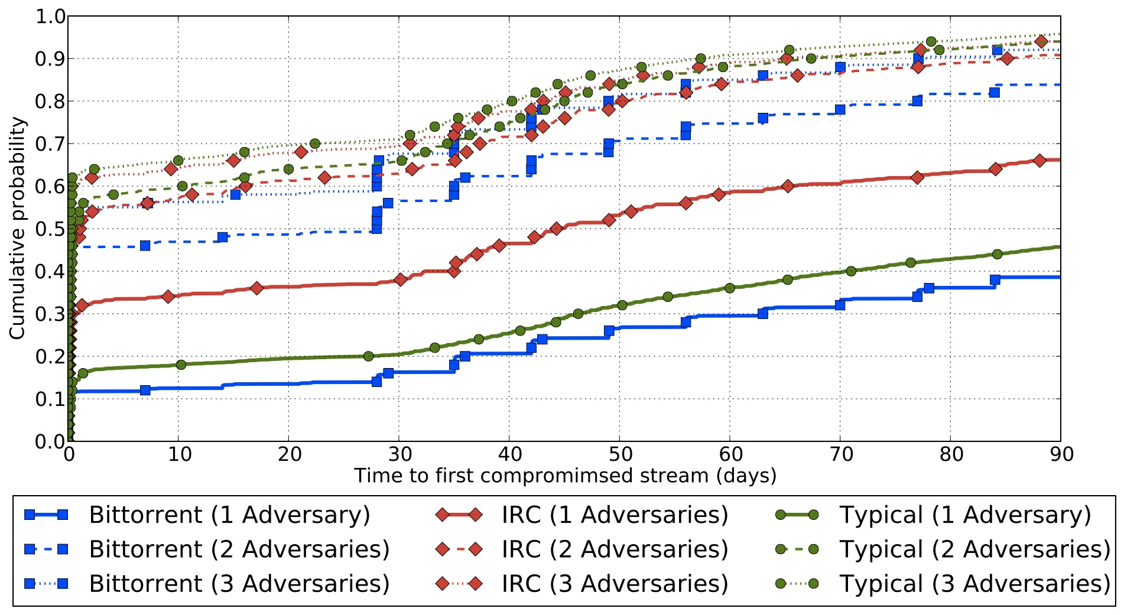
Link Adversary
Adversary controls IXP organization,
Time to first compromised stream,
1/13 – 3/13,
“Best”: most secure client AS
“Worst”: least secure client AS
Adversary controls top ASes,
Time to first compromised stream,
1/13 – 3/13,
Only “best” client AS

Slide 74
Overview
Background
Onion Routing Security Analysis
  Problem: Traffic correlation
  Adversary Model
  Security Metrics
  Evaluation Methodology
  Node Adversary Analysis
  Link Adversary Analysis
Future Work

Slide 75
Future Work
Extending analysis
Improving guard selection
Using trust-based path selection to protect against traffic correlation
Dealing with incomplete and inaccurate AS and IXP maps
Include Tor’s performance-based path-selection features in TorPS

